Slide 1
Students Housing
Rental System
Sihan Wu Wu4668@vandals.uidaho.edu
Benqi Zhang Zhan4669@vandals.uidaho.edu

Slide 2

HTML Structure
1
Home
Room Details
3
Admin Dashboard
4
User Dashboard
5
Landlord Dashboard
6
Contact
7
Log in/Sign up

Slide 3
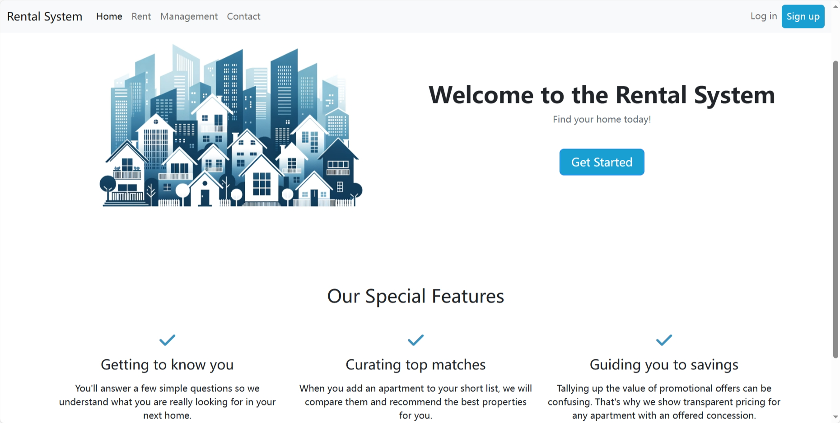
Home Page

Slide 4
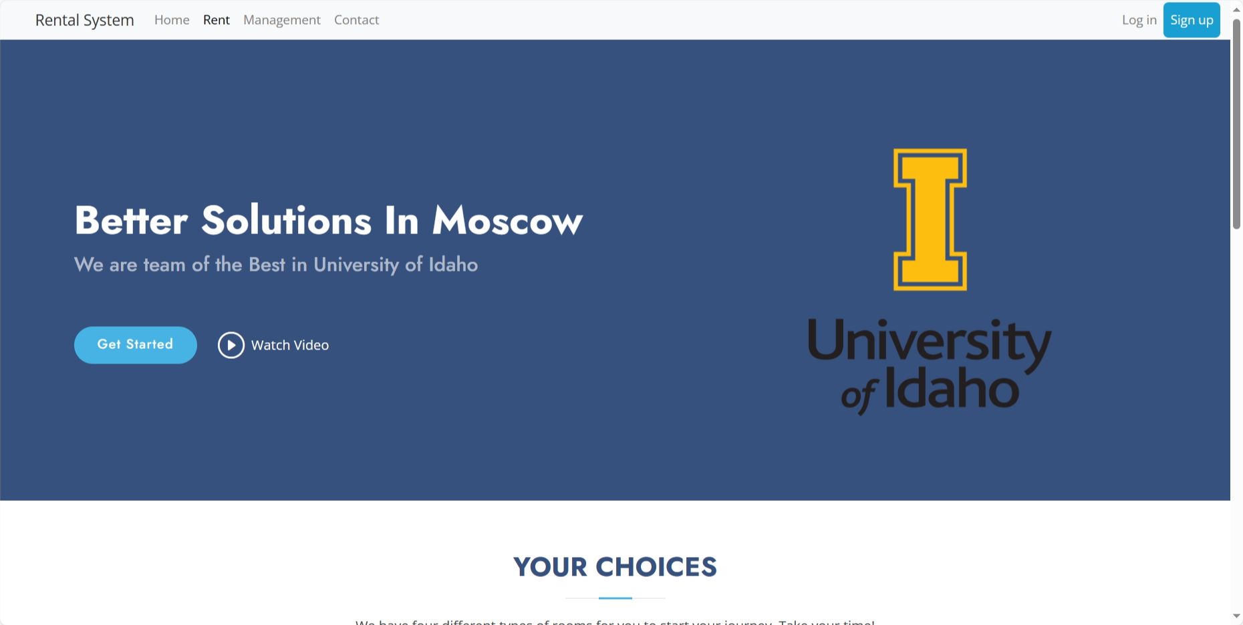
Room Details Page

Slide 5
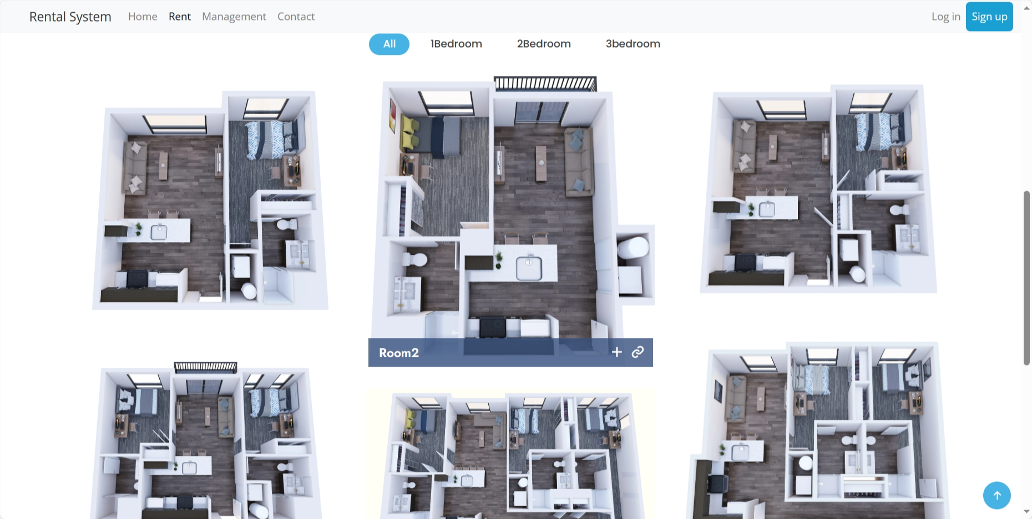
Room Details Page

Slide 6
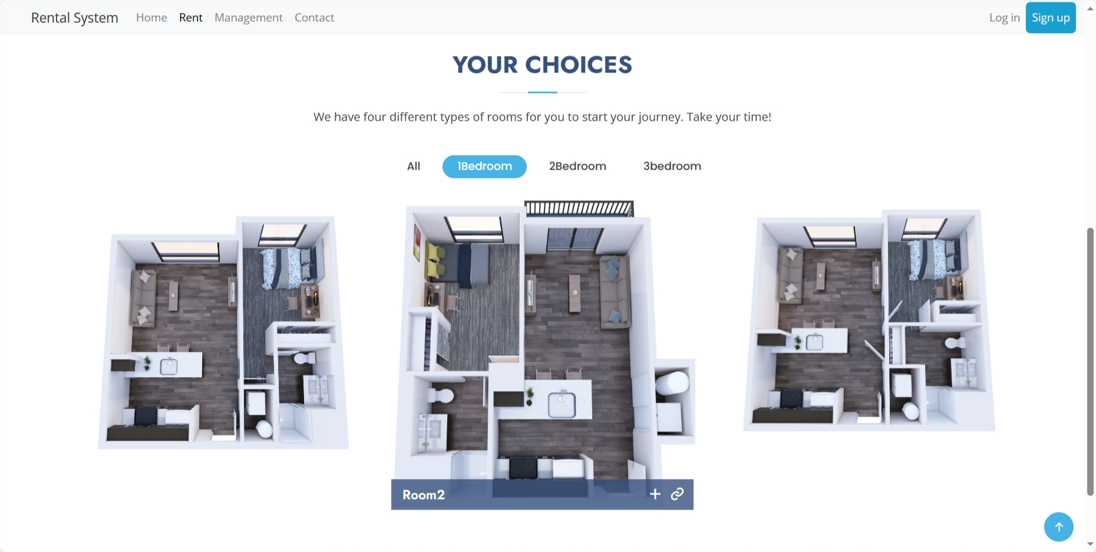
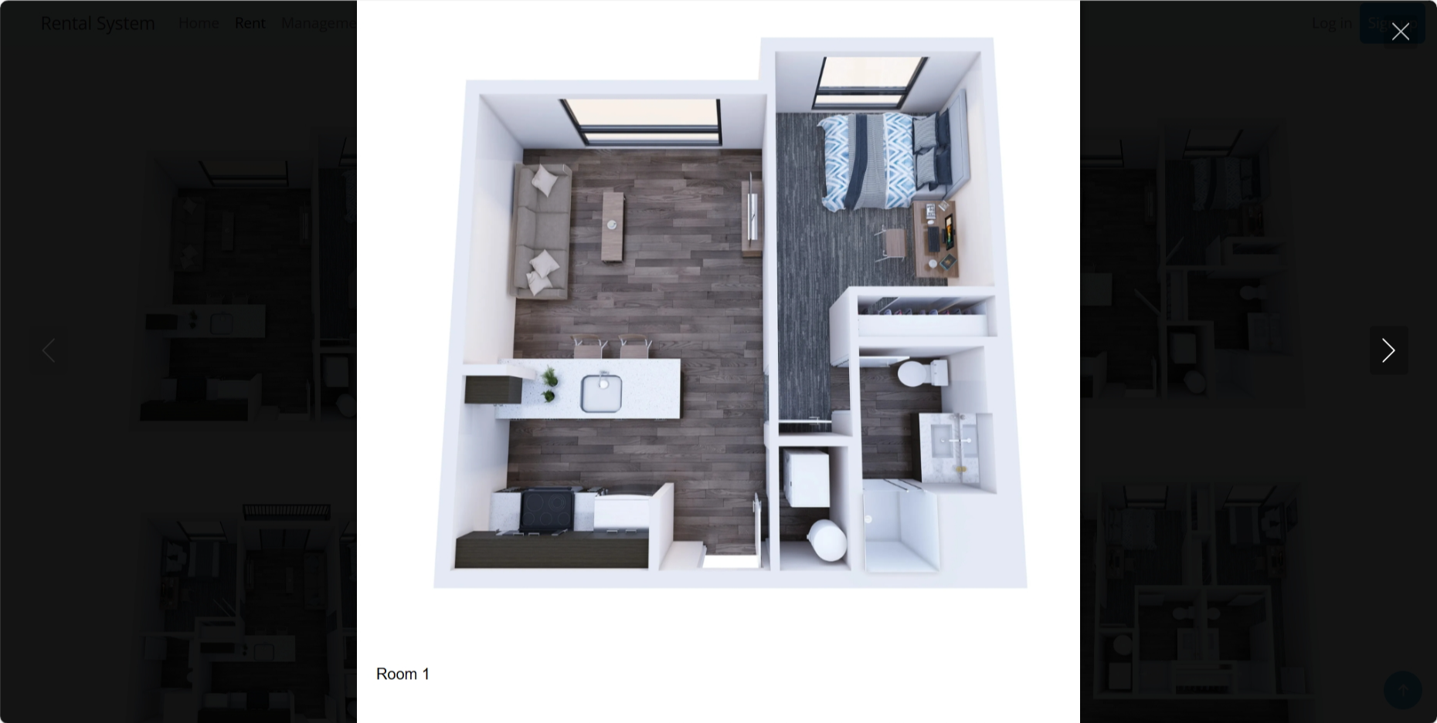
Room Details Page
Everyone can see all the types of rooms in the rent page, click to switch the room type and view the bigger picture

Slide 7
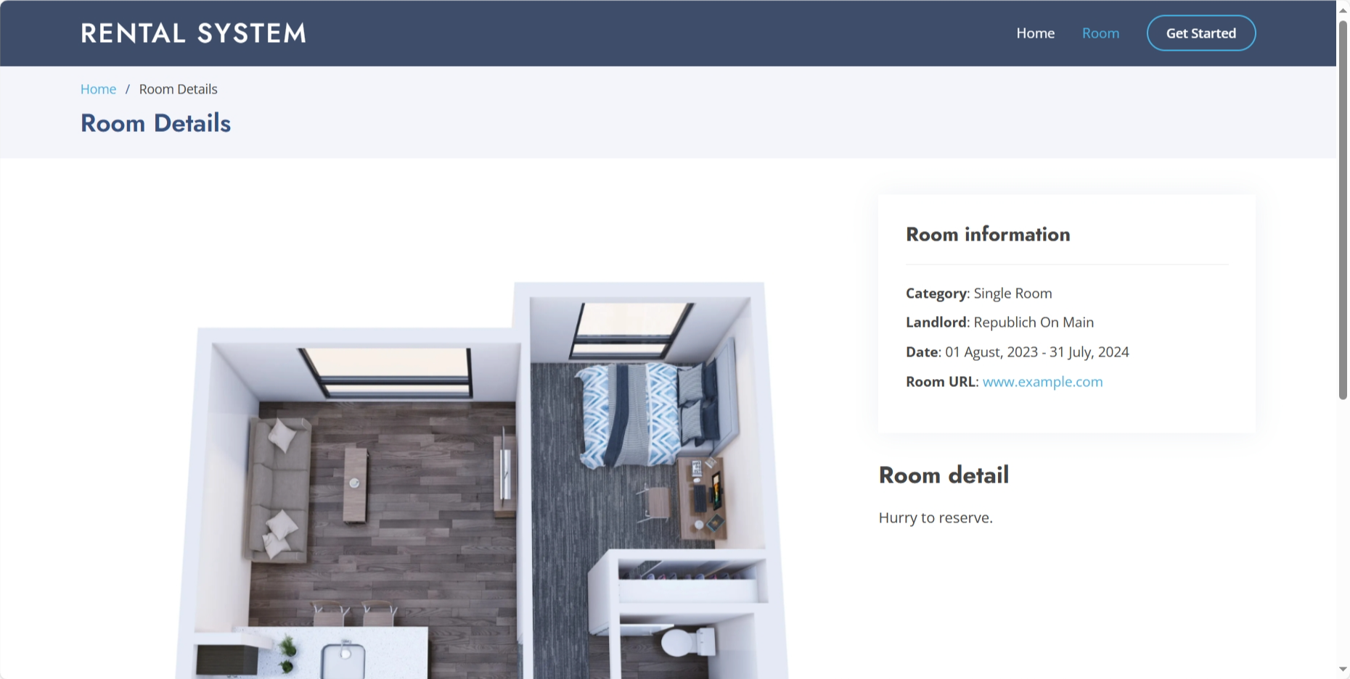
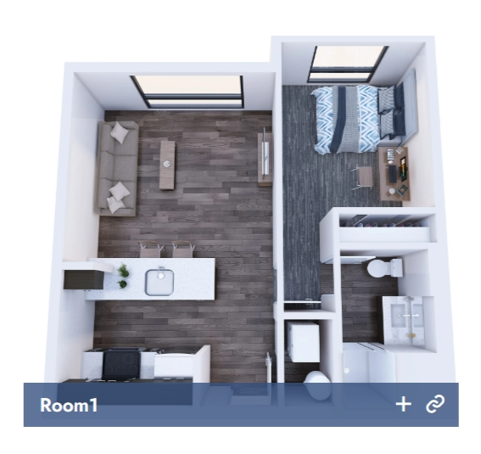
Room Details Page
Users can click to see the more detailed information in this page
Category, landlord, rental dates, company url

Slide 8
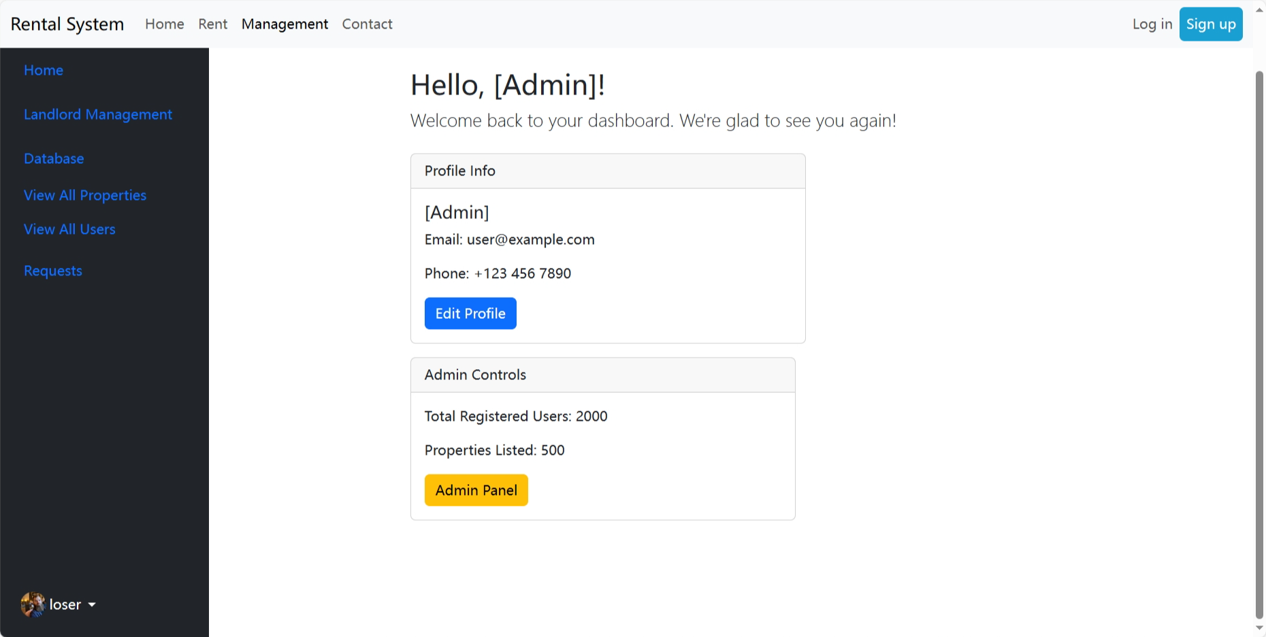
Admin Dashboard

Slide 9
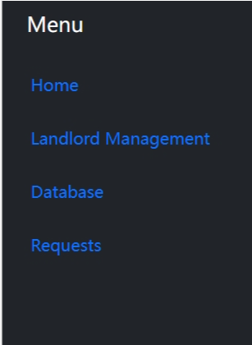
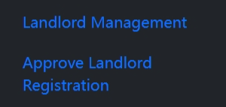
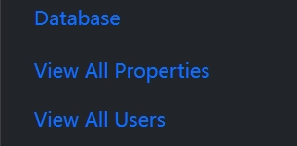
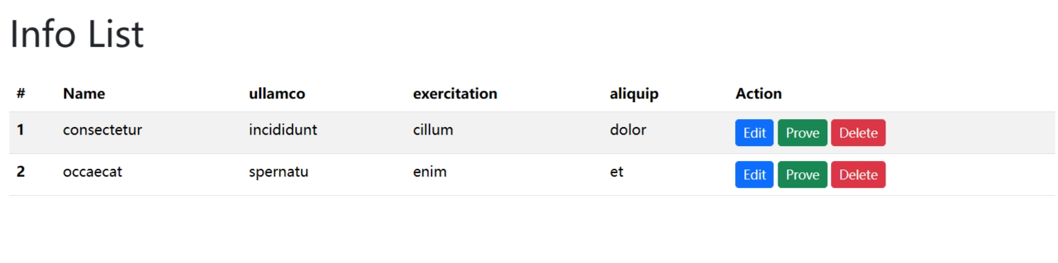
Admin Dashboard
We designed four main tabs, the managers can see the information of their properties, landlords, users, requests in the database

Slide 10
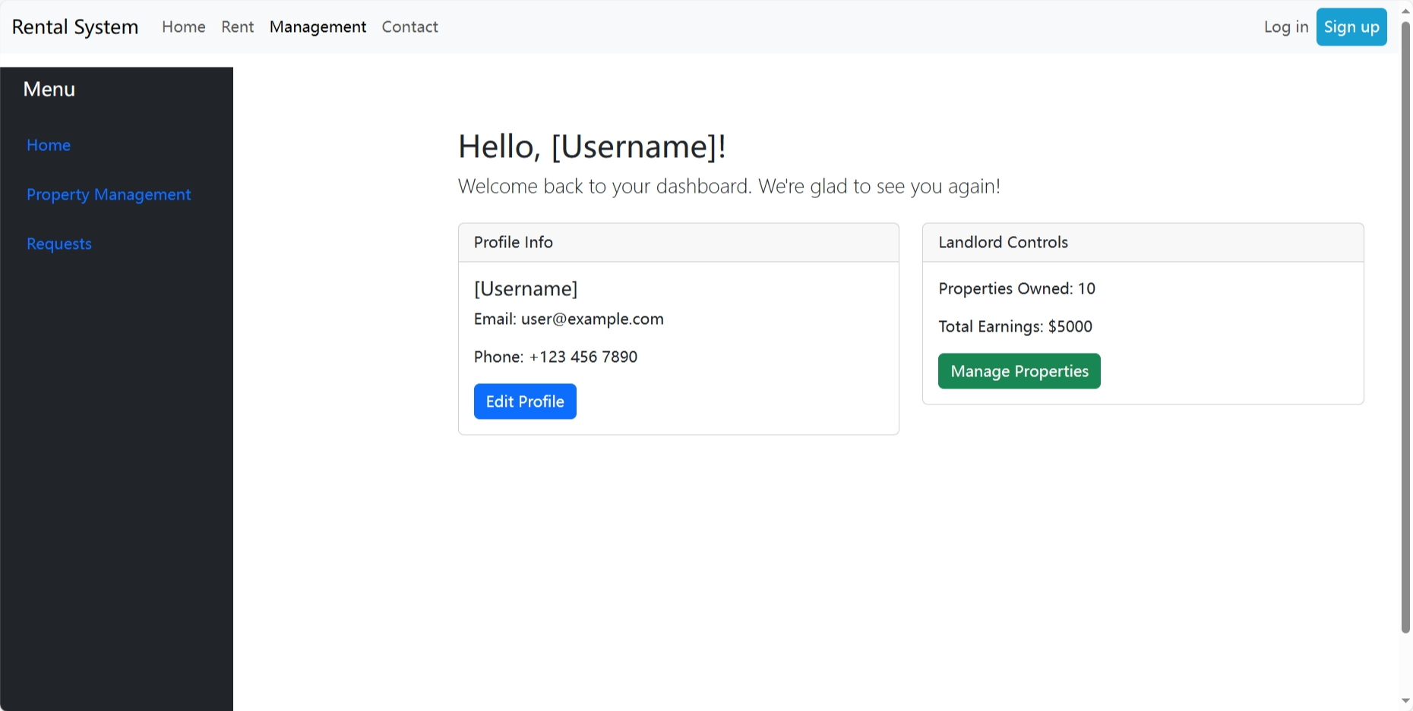
landlords Dashboard

Slide 11
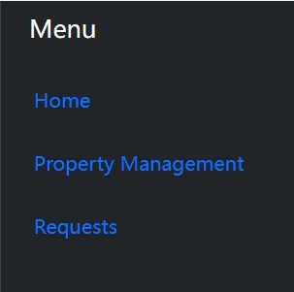
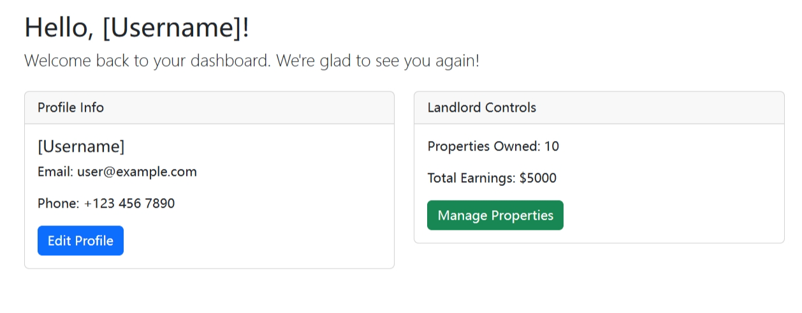
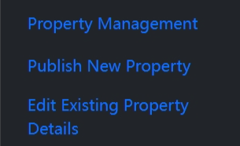
landlords Dashboard
We designed three main tabs for the landlords,
The landlords can publish and edit their properties

Slide 12
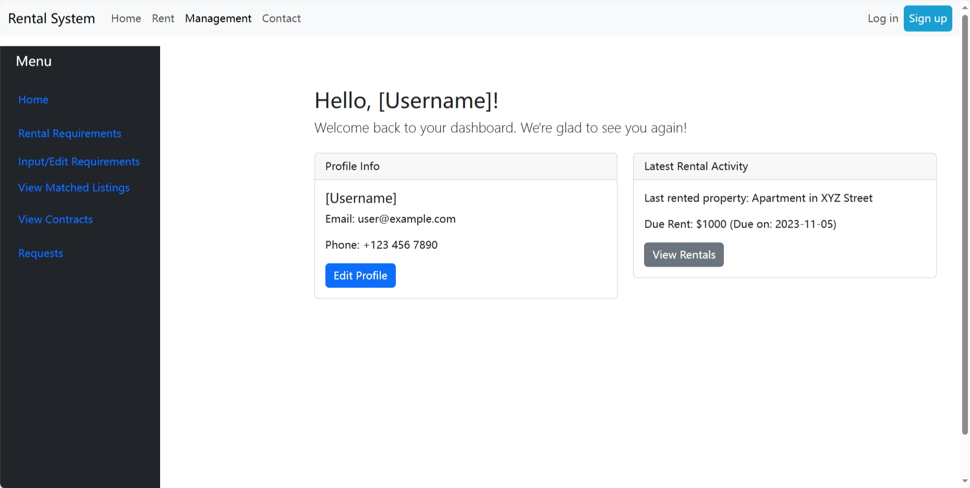
User Dashboard

Slide 13
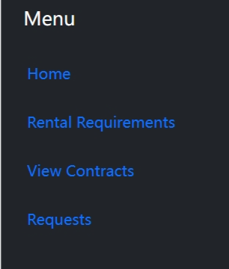
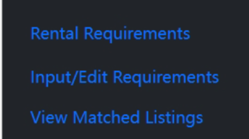
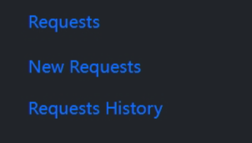
User Dashboard
We designed four main tabs, the function of rental requirements is allow users to input/edit their preferences and check the matching results

Slide 14
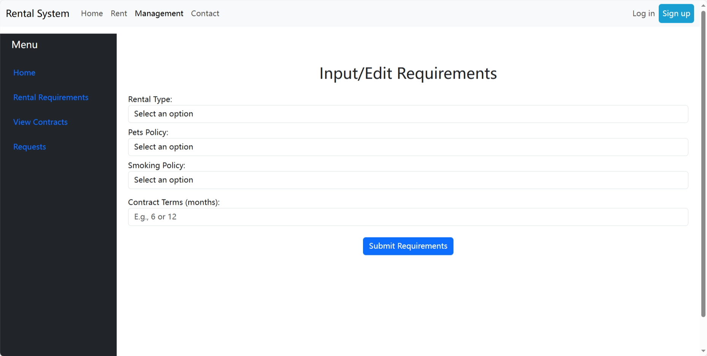
User Dashboard
This is the preference page, share/sole, cat/dog/not, smoke/drink/not

Slide 15
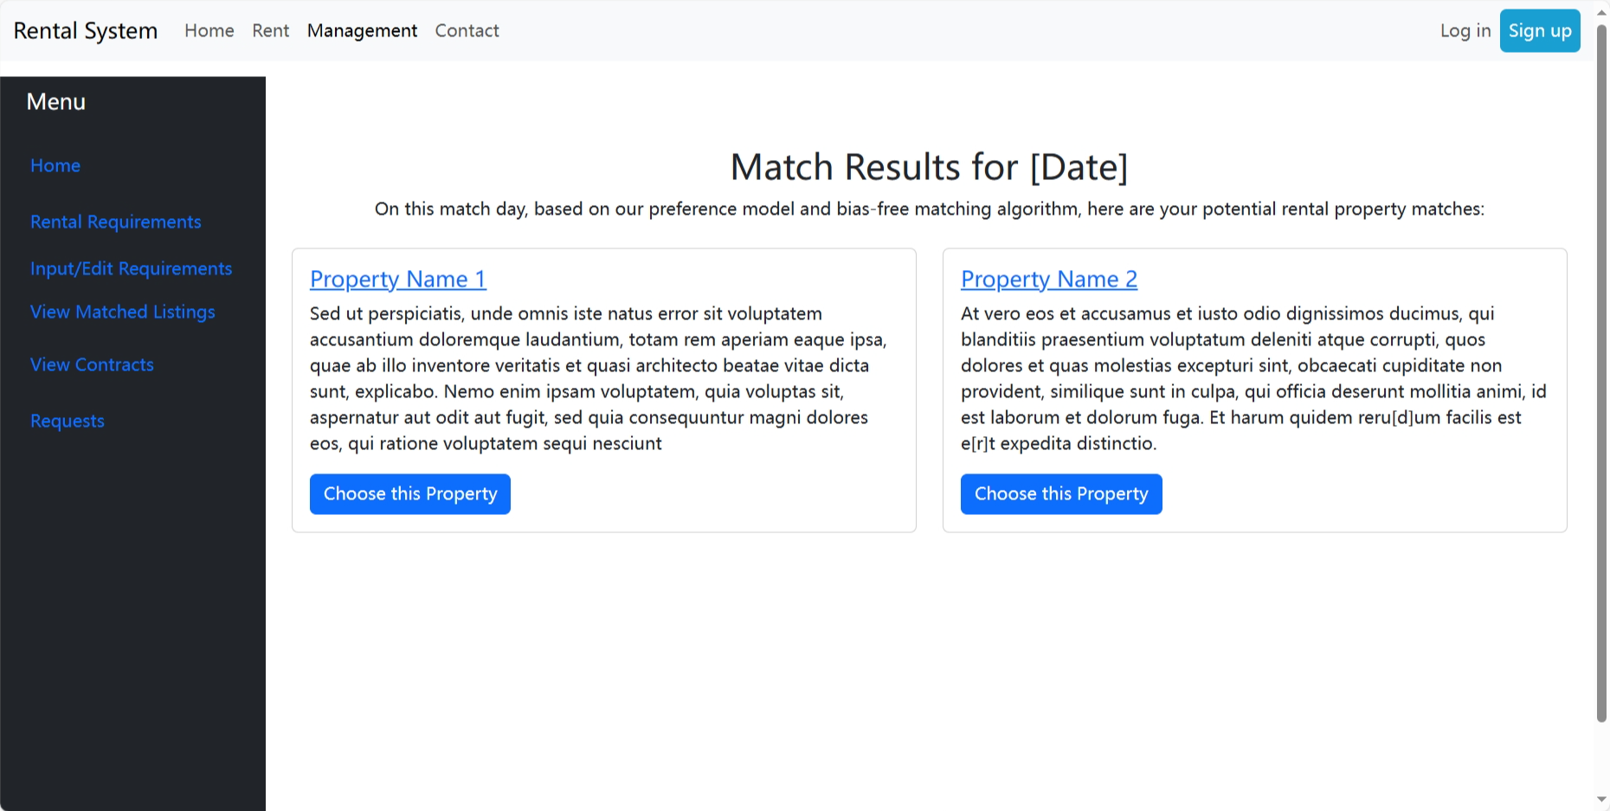
User Dashboard
This is the match page, users can see the properties provide by the system

Slide 16
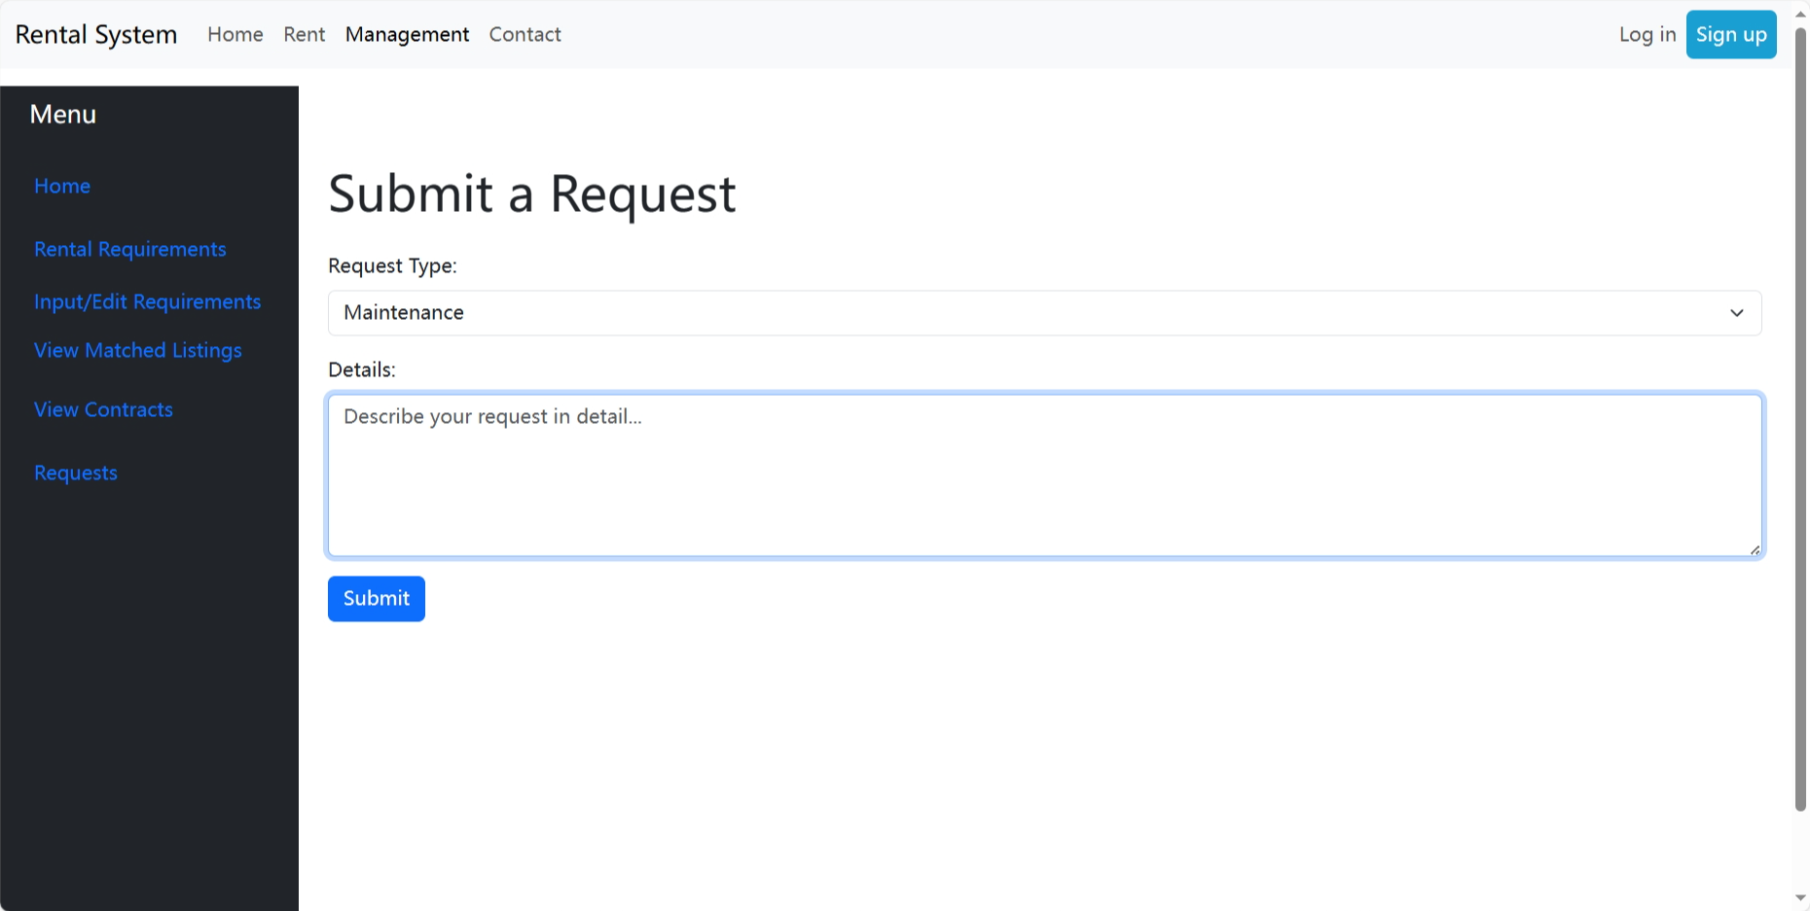
User Dashboard
This is the request page, users can request maintenance, movements and complains requirements

Slide 17
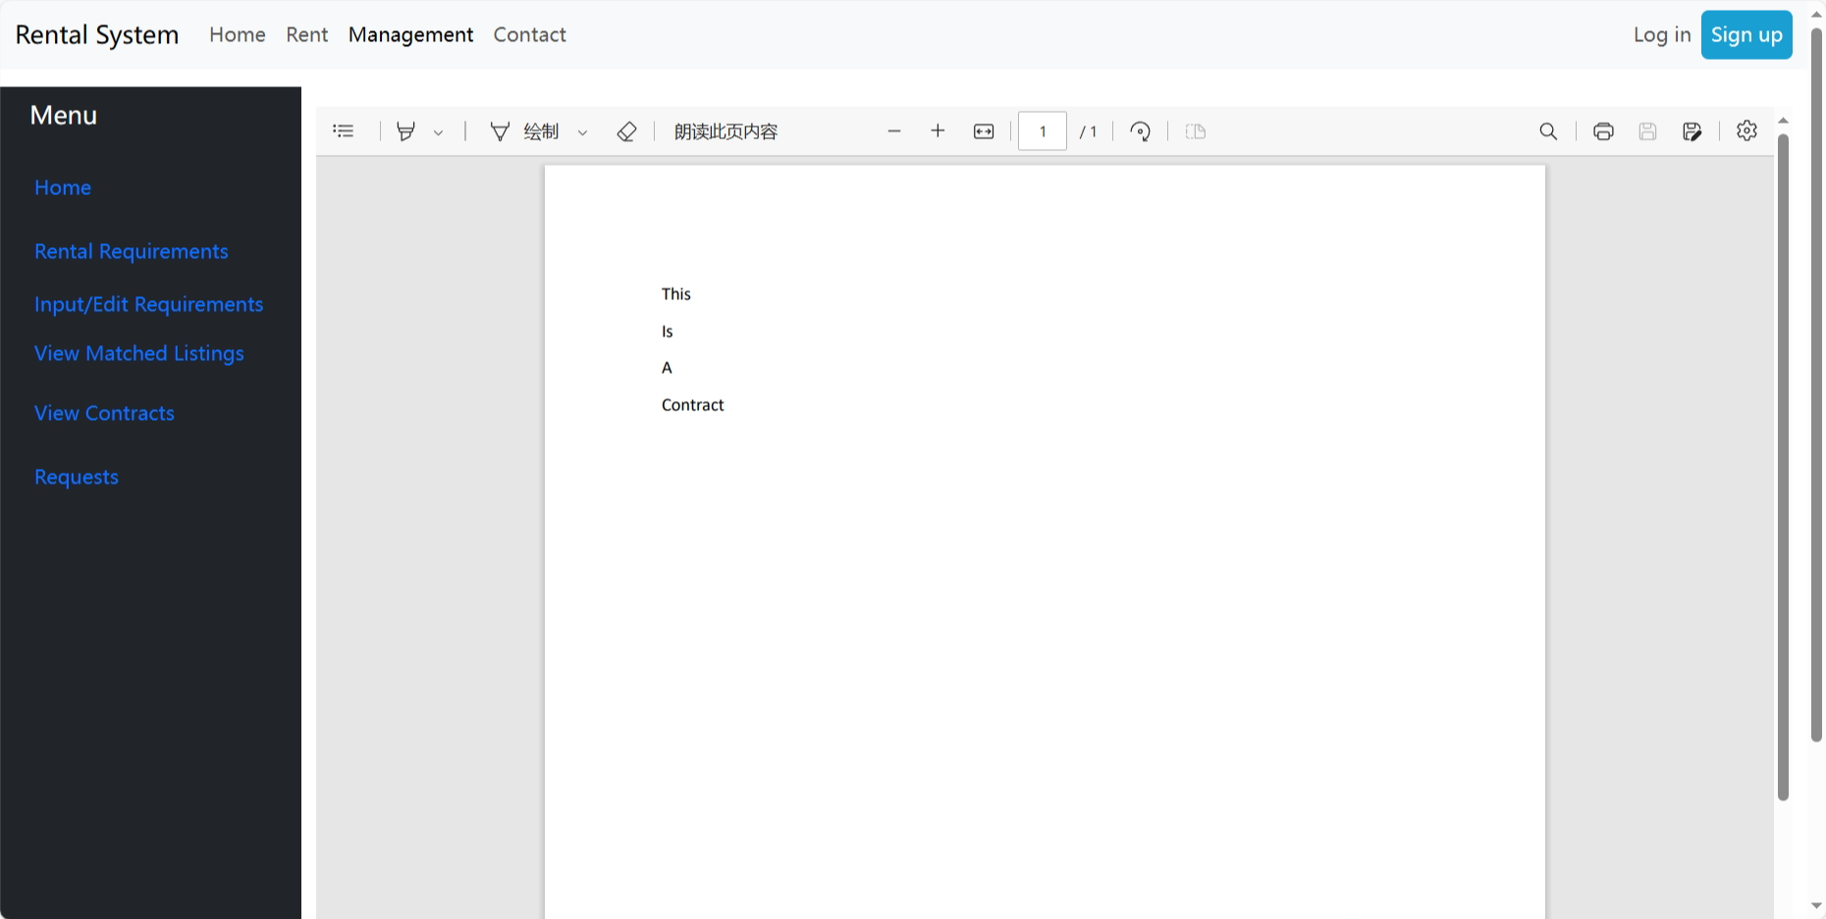
User Dashboard
This is the contract page, users can view their contracts signed with landlords

Slide 18
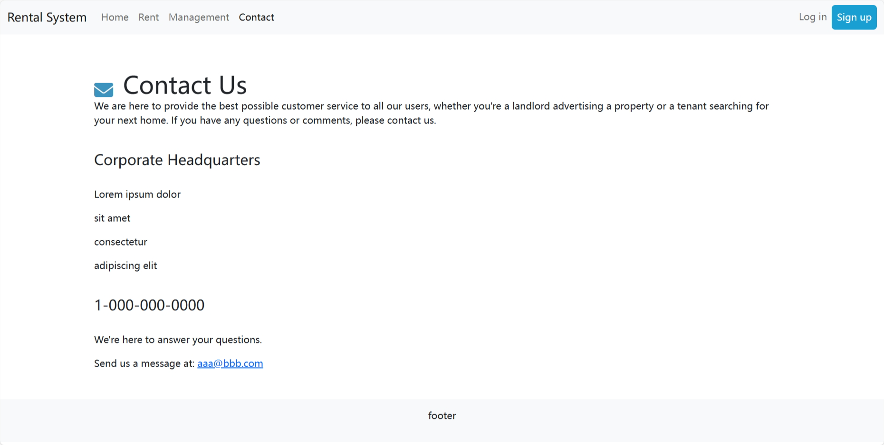
Contact
This is the contact page ,includes manager’s information

Slide 19
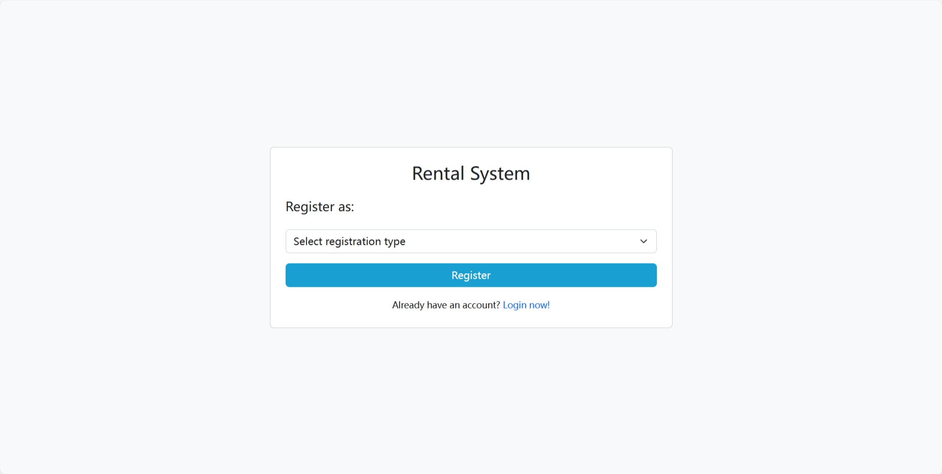
Sign up
Users can register as managers, students and landlords

Slide 20
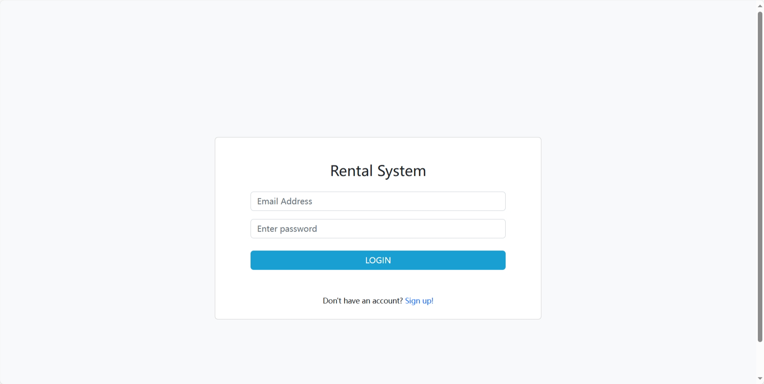
Login

Slide 21
Thank
you
Sihan Wu Wu4668@vandals.uidaho.edu
Benqi Zhang Zhan4669@vandals.uidaho.edu

